Slide 1
Students food choices
Machine Learning
ABDI Myriam
BARAKET Sandra
ING 4

Slide 2

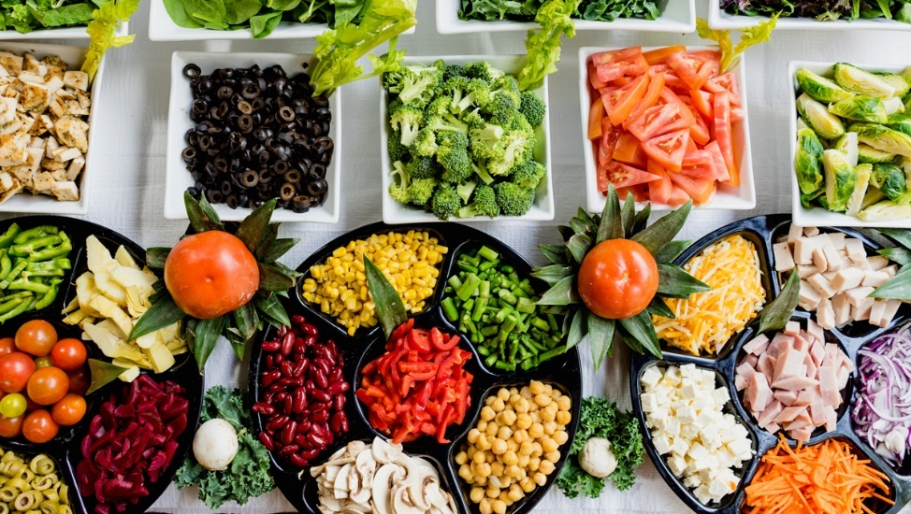
The why ?

Slide 3
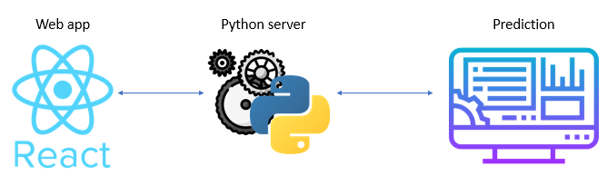
OUR PROJECT

Slide 4

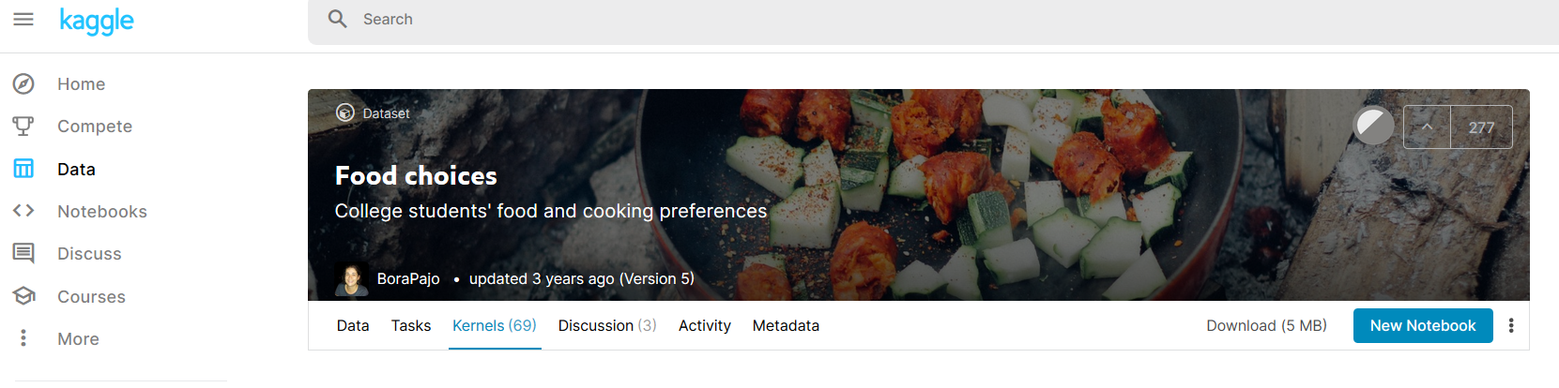
The dataset
https://www.kaggle.com/borapajo/food-choices/

Slide 5
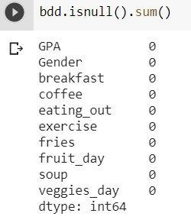
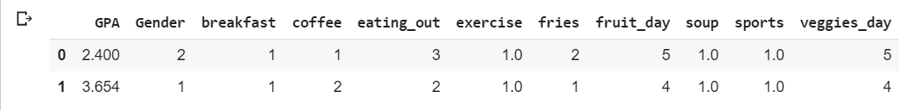
DATA CLEANING

Slide 6
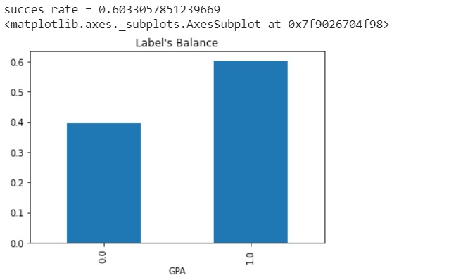
visualization
Visualisation du taux de réussite des students selon leurs GPA

Slide 7
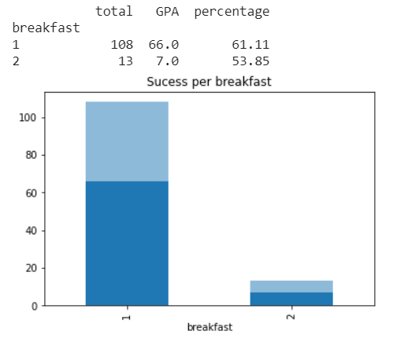
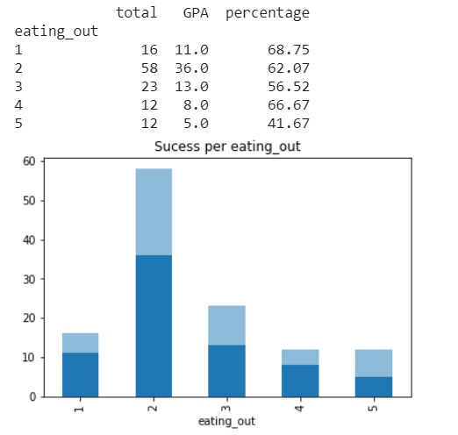
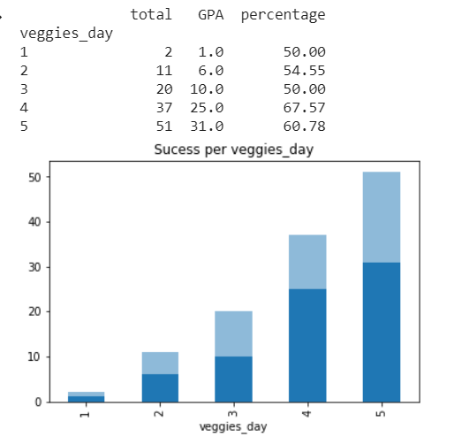
visualization

